Slide 1


Exploratory Data Analysis of
King County
02/20/2026
by Isabell Durieux

Slide 2

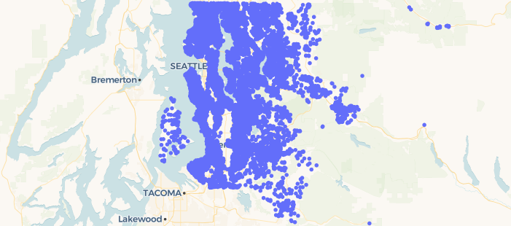
- Invest in poor neighborhood - Buying & selling - Costs back + little profit - Socially responsible
Buying requirements
Houses of King County
Goal: Recommendations for affordable houses in King County

Slide 3

Summary of Hypotheses
Hypothesis 1: The lower the grade and condition, the cheaper the house
Hypothesis 2: Cheap houses are accumulated in a specific council district
Hypothesis 3: Houses at the waterfront are more expensive compared to houses without a waterfront

Slide 4

Data analysis
Data overview Target variable: Price
Main features: Bedrooms, bathrooms, sqft living, sqft lot, floors, sqft above, sqft basement, sqft living 15, sqft lot15, date of selling
Quality and location factors: Waterfront, view, condition, grade, zipcode, lat, long
Age, Modernization: Year built, year renovated
Quality and location factors
Parameter |  | Information
Condition |  | How good is the overall condition of the house
Grade |  | Overall grade given to the housing unit, based on King County grading system
Lat |  | Latitude coordinate
Long |  | Longitude coordinate
Price |  | Is prediction target
Waterfront |  | House which has a view to a waterfront
Id |  | Unique identified for a house

Slide 5
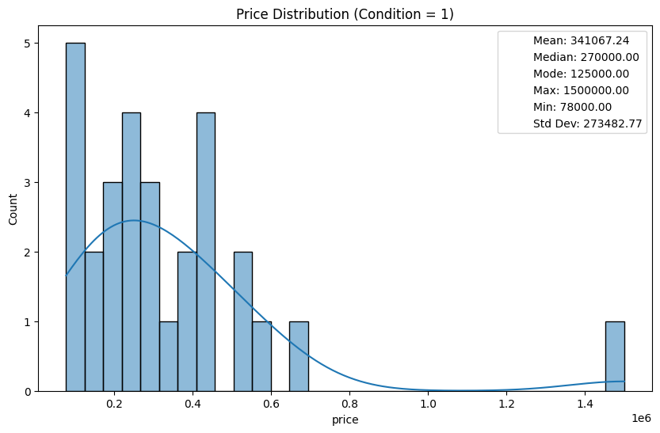
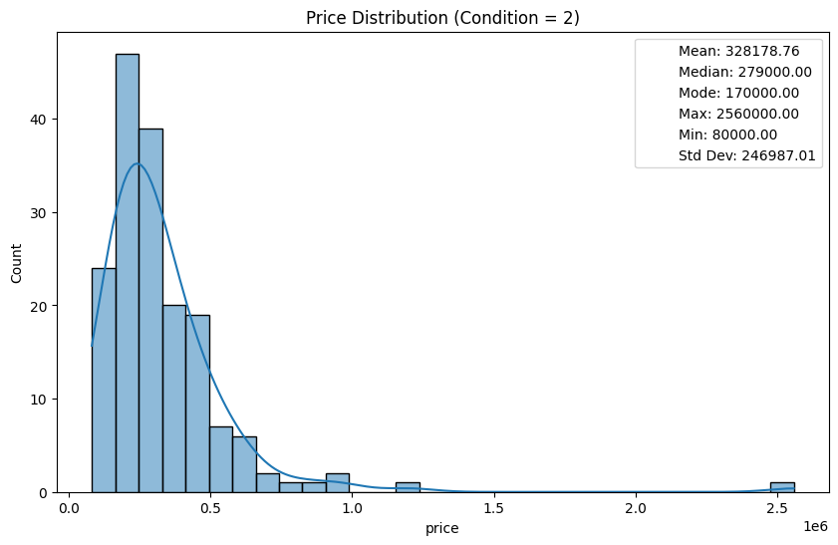
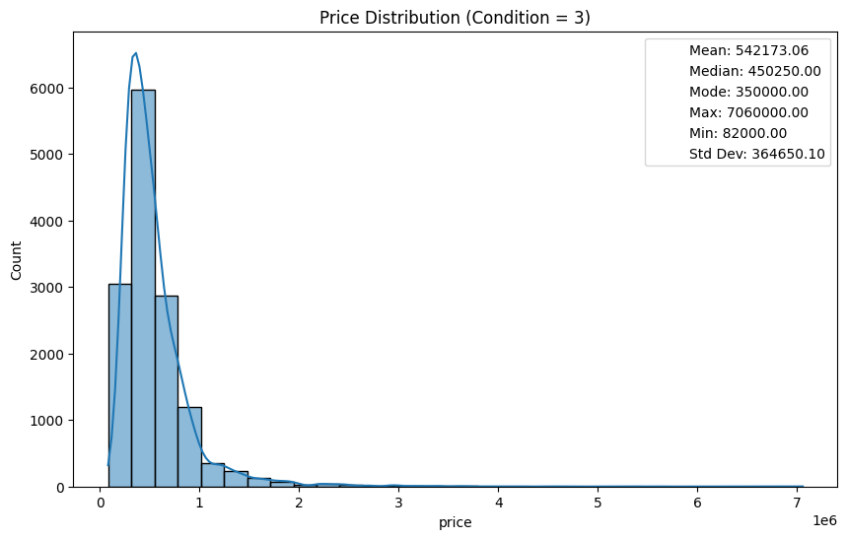
Hypothesis 1: The lower the grade and condition, the cheaper the house Price distribution of conditions 1-5
Condition 1
Condition 2
Condition 3
Condition 4 and 5 were plotted in the same way as the other conditions.
House prices generally increase with better condition
The standard deviation increases with condition, suggesting greater price variability among homes in better condition
Condition | Mean price in mio dollar | Median price in mio dollar | Mode price in mio dollar | Max price in mio dollar | Min price in mio dollar | Std. dev. in mio dollar
1 | 0,341 | 0,270 | 0,125 | 1,500 | 0,078 | 0,273
2 | 0,328 | 0,279 | 0,170 | 2,560 | 0,080 | 0,247
3 | 0,542 | 0,450 | 0,350 | 7,060 | 0,082 | 0,365
4 | 0,521 | 0,440 | 0,450 | 7,700 | 0,089 | 0,359
5 | 0,613 | 0,526 | 0,550 | 3,650 | 0,110 | 0,411

Slide 6
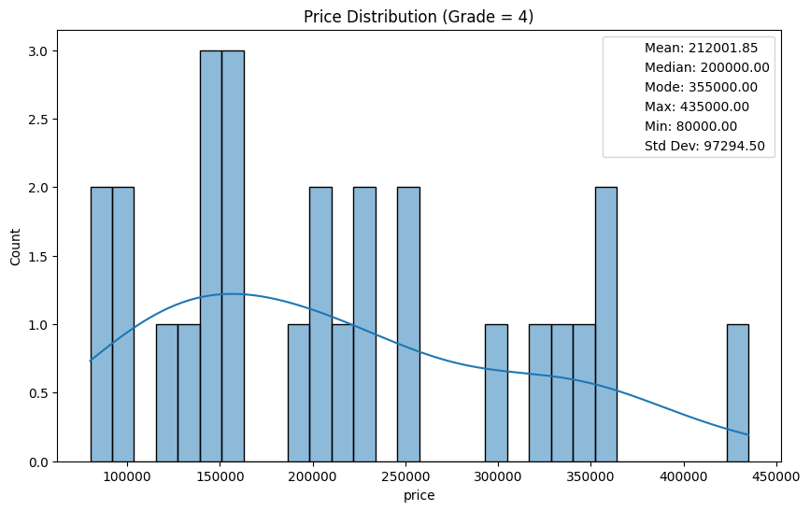
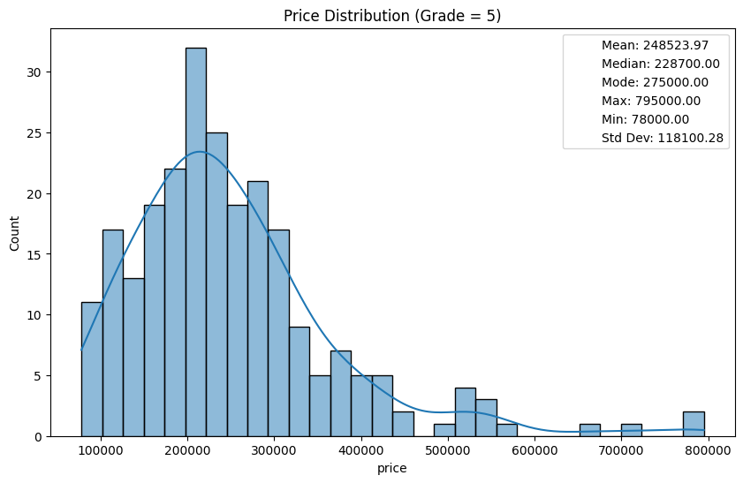
Hypothesis 1: The lower the grade and condition, the cheaper the house Price distribution of grade 3-13
Grade 4
Grade |  | Mean price in mio dollar | Median price in mio dollar | Mode price in mio dollar | Max price in mio dollar | Min price in mio dollar | Std. dev. in mio dollar
3 |  | 0,262 | 0,262 | 0,262 | 0,262 | 0,262 | nan
4 |  | 0,212 | 0,200 | 0,355 | 0,435 | 0,080 | 0,097
5 |  | 0,249 | 0,229 | 0,275 | 0,795 | 0,078 | 0,118
6 |  | 0,302 | 0,275 | 0,250 | 1,200 | 0,082 | 0,123
7 |  | 0,403 | 0,375 | 0,350 | 2,050 | 0,090 | 0,156
8 |  | 0,543 | 0,510 | 0,550 | 3,070 | 0,140 | 0,218
9 |  | 0,774 | 0,720 | 0,650 | 2,300 | 0,230 | 0,317
10 |  | 1,072 | 0,914 | 1,050 | 3,600 | 0,316 | 0,484
11 |  | 1,498 | 1,280 | 1,150 | 7,060 | 0,420 | 0,705
12 |  | 2,203 | 1,820 | 1,490 | 5,350 | 0,835 | 1,029
13 |  | 3,711 | 2,980 | 3,800 | 7,700 | 0,178 | 1,859
Grade 5
Grade 3, and 7-13 were plotted in the same way as the other conditions.
The table shows that house prices increase strongly with higher grade levels.

Slide 7
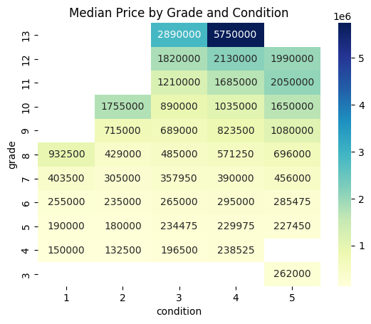
Lower grades and conditions are associated with lower median prices of homes
The heatmap shows the median house price by grade (y-axis) and condition (x-axis)
Higher grades (especially 10–13) are associated with substantially higher median prices
Condition has a positive but smaller impact compared to grade on median prices
Hypothesis 1 is confirmed
Focus on lower grades (grade 4-7) and conditions (condition 1-3) to find houses

Slide 8
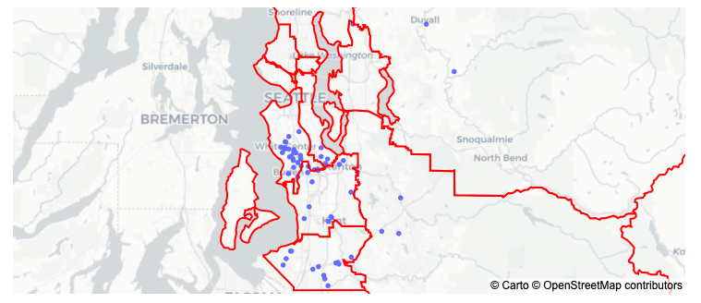
Hypothesis 2: Cheap houses are accumulated in a specific council district
Definition cheap houses: Up to 120,000 dollars
9 King County Council Districts
1
4
4
6
8
2
3
8
5
7
9
Most accumulation of cheap houses in district 5, 7, and 8
Hypothesis 2 is confirmed

Slide 9
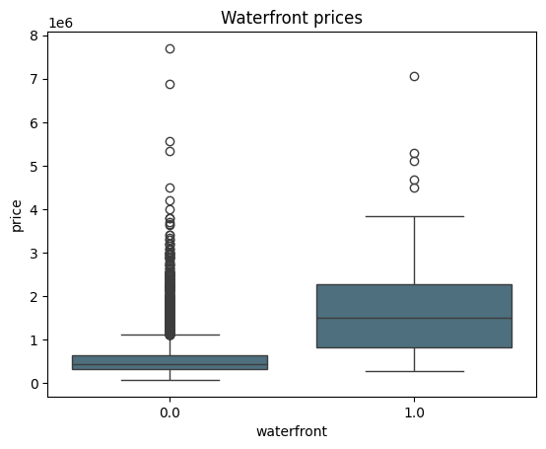
Hypothesis 3: Houses at the waterfront are more expensive compared to houses wo a waterfront
Waterfront | Mean price | Median price | Max price | Min price | Std. dev. price
Yes | 0.533 | 0.450 | 7.700 | 0.078 | 0.345
No | 1.717 | 1.510 | 7.060 | 0.285 | 1.145
Prices of houses with a waterfront are 3x higher compared to houses without a waterfront
Focus on houses without a waterfront
Hypothesis 3 is confirmed

Slide 10
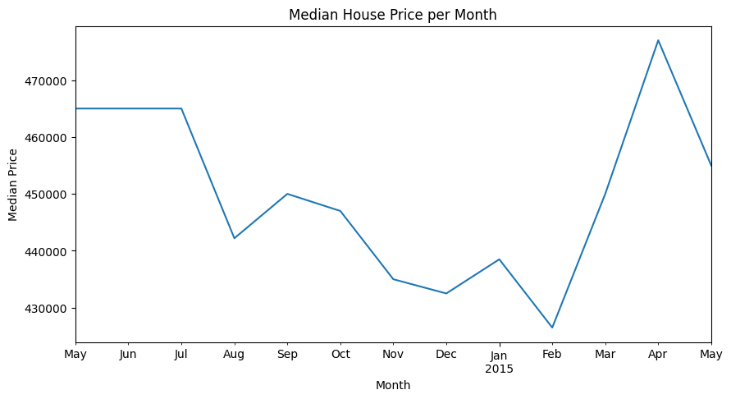
Recommendations for houses
Year 2014: 450,000 dollar
Year 2015: 451,000 dollar
Summary house research
Focus on lower grades (grade 4-7) and conditions (condition 1-3)
Most accumulation of affordable houses in district 5, 7, 8
Focus on houses without a waterfront
Lower prices on the house market between November and February

Slide 11
Recommendations for affordable houses
🟦 District 4 – Zentrales Seattle
(Ballard, Queen Anne, Magnolia, Greenwood) Warum hohe Fluktuation?
Hohe Nachfrage
Viele Eigentumswohnungen & kleinere Häuser
Investorenaktivität
Gute Vermietbarkeit
➡️ Hoher Umschlag + hohe Preisvolatilität
🟩 District 6 – Eastside (Bellevue, Redmond, Kirkland)
Tech-Hotspot (Microsoft, Amazon-Nähe)
Sehr hohe Preise
Stark abhängig vom Tech-Arbeitsmarkt
Viele Umzüge wegen Jobwechsel
➡️ Sehr hohe Preisfluktuation, besonders in Boom-/Zinsphasen
🟨 District 7 – South Seattle / Renton / Tukwila
Vergleichsweise „erschwinglicher“ Markt
Viele Erstkäufer
Starke Nachfrageverschiebungen bei Zinsänderungen
➡️ Hohe Transaktionsfrequenz, teils starke Preisbewegungen
📍 Mittlere Fluktuation
🟧 District 3 – Eastside Vororte (Issaquah, Sammamish)
Familienorientierte Gebiete
Weniger kurzfristige Verkäufe ➡️ Stabiler als zentrale Stadtteile
📍 Niedrigere Fluktuation
🟫 District 1 – ländlicher Norden (Vashon, Shoreline, Woodinville)
Größere Grundstücke
Weniger Spekulation
Längere Besitzdauer
➡️ Weniger Turnover, stabilere Märkte
Summary of results
-
small house for one person bigger house for 2 persons family house for 3-4 persons
In welchem Distrikt gibt es hohe Fluktuationen vom Häuserkauf?
Das wäre gut für Erin, weil sie ja kaufen und wieder verkaufen möchte

Slide 12
Exploratory Data Analysis of King County
02/20/2026
by Isabell Durieux

Slide 13


EDA project Isabell Durieux

Slide 14
EDA project
Data science cohort
by Isabell Durieux
02/20/2026

Slide 15



- Invest in poor neighborhood - Buying & selling - Costs back + little profit - Socially responsible
Client: Erin Robinson
Goal: Find 3 houses for Erin in King County

Slide 16
Data introduction condition, grade, price, waterfront
Intro to the dataset
Intro about client
Intro about quality of data
who are you, who is your client
what data are you working on (time span, location, size)
data overview
introducing your 3 main hypotheses
the results of the analysis of the hypotheses (visual/statistical)
insights and recommendations for client

Slide 17
EDA project
02/20/2026
by Isabell Durieux

Slide 18
Data EDA project
Data overview
id, bedrooms, bathrooms, sqft living, sqft lot, floors, waterfront, view, condition, grade, sqft above, sqft basement, yr built, yr renovated, zipcode, lat, long, sqft living 15, sqft lot15, date, price
Data I worked on
Condition: How good the condition is (overall)
Grade: Overall grade given to the housing unit, based on King County grading system
Lat: Latitude coordinate
Long: Longitude coordinate
Price: Is prediction target
Waterfront: House which has a view to a waterfront
Id: Unique identified for a house

Slide 19
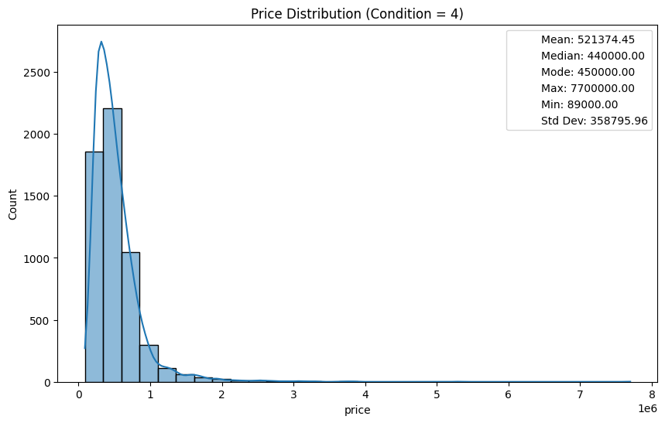
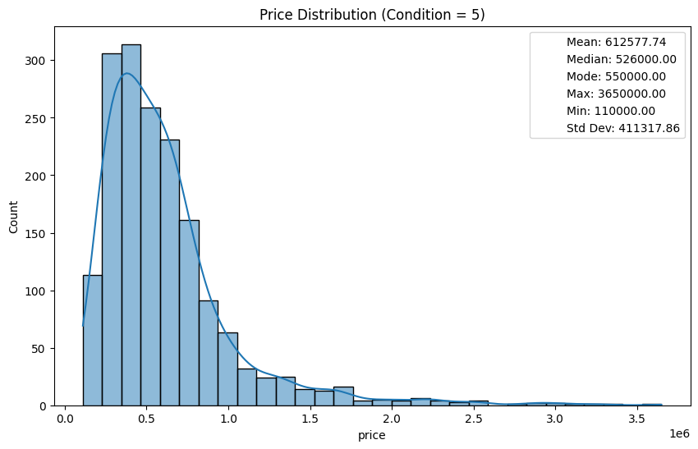
1. Hypothesis: The lower the grade and condition, the cheaper the house Price distribution of conditions 1-5
Mean price in dollar
Condition 1: 341,000
Condition 2: 328,00
Condition 3: 542,000
Condition 4: 521,000
Condition 5: 613,000
Median price in dollar
Condition 1: 270,000
Condition 2: 279,000
Condition 3: 450,000
Condition 4: 440,000
Condition 5: 526,000
Mode price in dollar
Condition 1: 125,000
Condition 2: 170,000
Condition 3: 350,250
Condition 4: 450,000
Condition 5: 550,000
Std price in dollar
Condition 1: 273,000
Condition 2: 247,000
Condition 3: 365,000
Condition 4: 359,000
Condition 5: 411,000
Max price in dollar
Condition 1: 1,500,000
Condition 2: 2,560,000
Condition 3: 7,060,000
Condition 4: 7,700,000
Condition 5: 3,650,000
Min price in dollar
Condition 1: 78,000
Condition 2: 80,000
Condition 3: 82,000
Condition 4: 89,000
Condition 5: 110,000
Hypothesis is right
Seaborn and Matplotlib

Slide 20
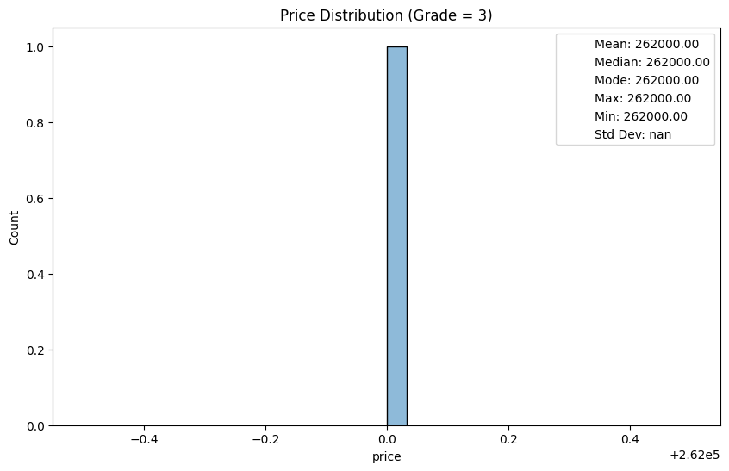
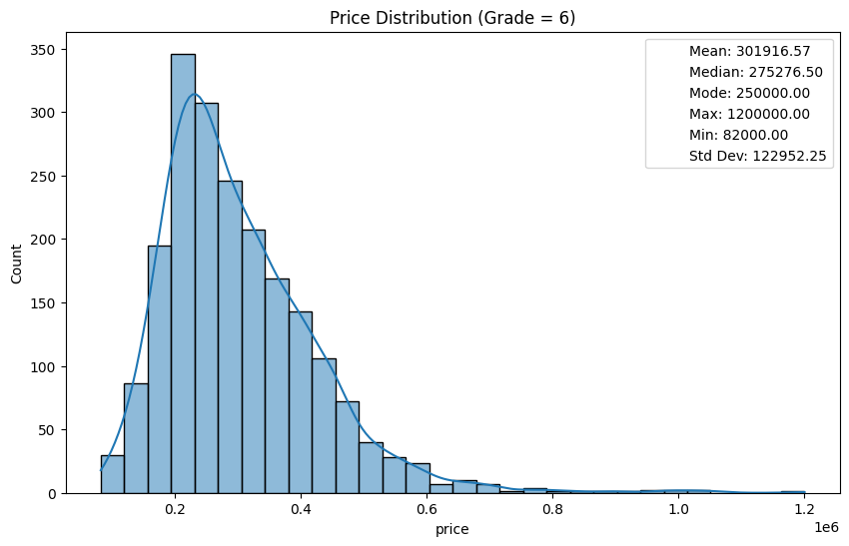
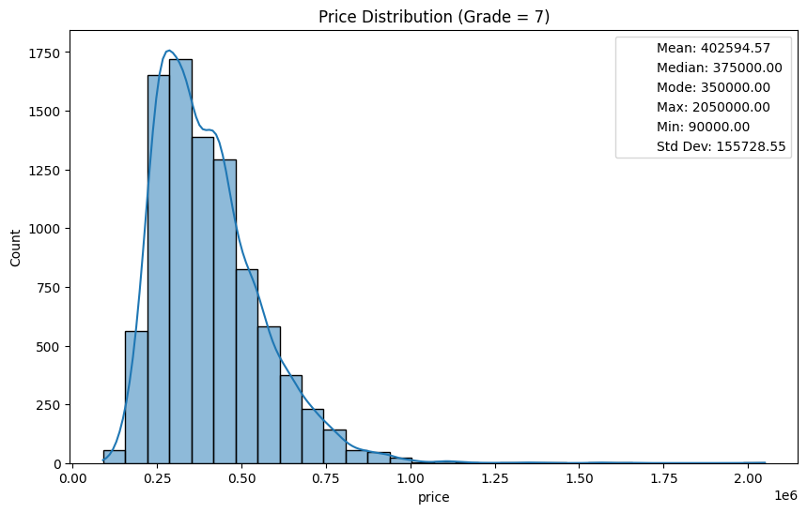
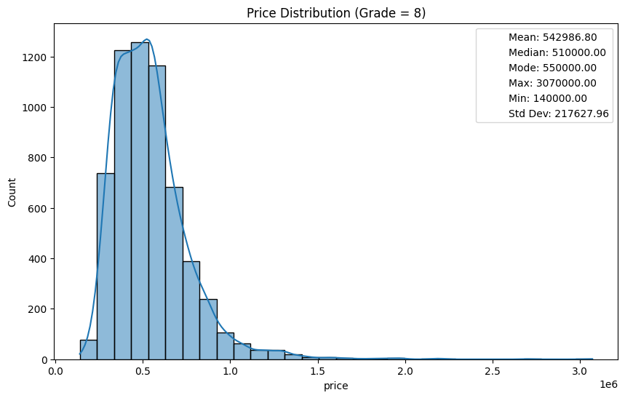
1. Hypotheses: The lower the grade and condition, the cheaper the houses Price distribution of grades 3-13
Mean price in dollar
Grade 3: 262,000
Grade 4: 212,000
Grade 5: 249,000
Grade 6: 302,000
Grade 7: 403,000
Grade 8: 543,000
Median price in dollar
Grade 3: 262,000
Grade 4: 200,000
Grade 5: 229,000
Grade 6: 275,000
Grade 7: 375,000
Grade 8: 510,000
Mode price in dollar
Grade 3: 262,000
Grade 4: 355,000
Grade 5: 275,000
Grade 6: 250,000
Grade 7: 350,000
Grade 8: 550,000
Std deviation in dollar
Grade 3: nan
Grade 4: 97,000
Grade 5: 118,000
Grade 6: 123,000
Grade 7: 156,000
Grade 8: 218,000
Max in dollar
Grade 3: 262,000
Grade 4: 435,000
Grade 5: 795,000
Grade 6: 1,200,000
Grade 7: 2,050,000
Grade 8: 3,070,000
Min price in dollar
Grade 3: 262,000
Grade 4: 80,000
Grade 5: 78,000
Grade 6: 82,000
Grade 7: 90,000
Grade 8: 140,000
Seaborn and Matplotlib

Slide 21
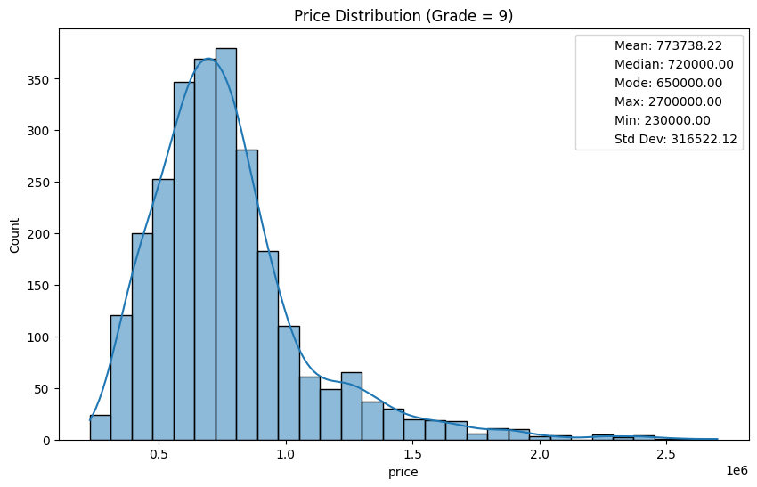
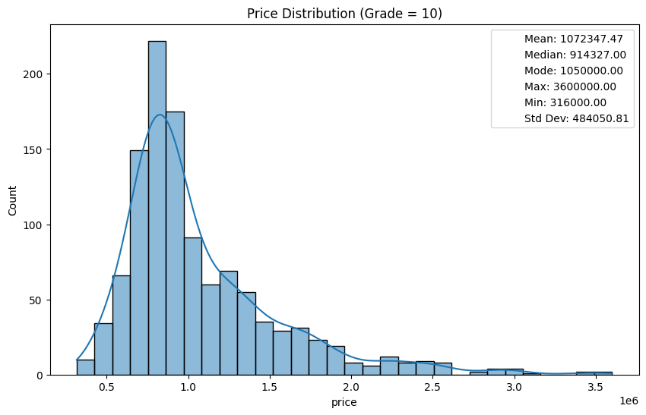
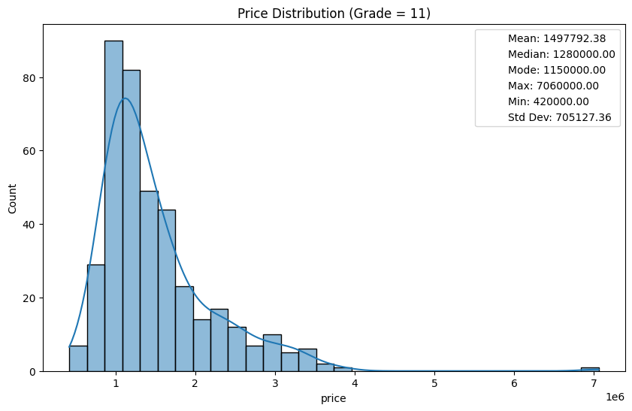
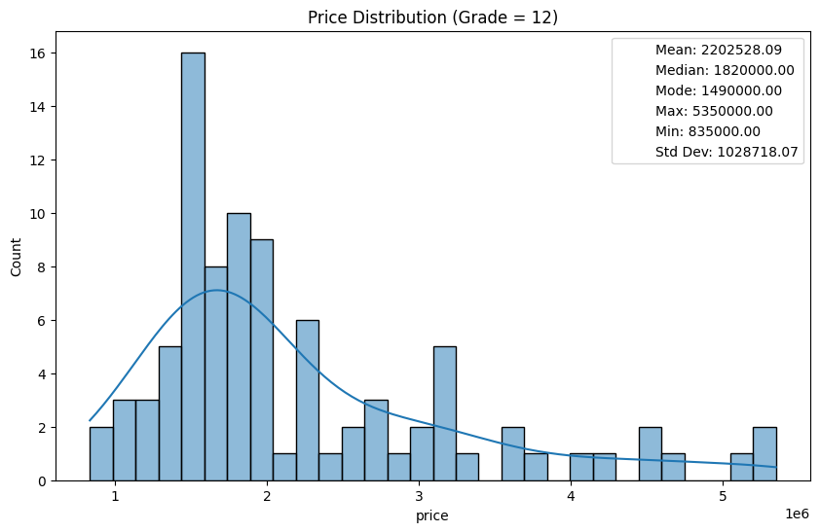
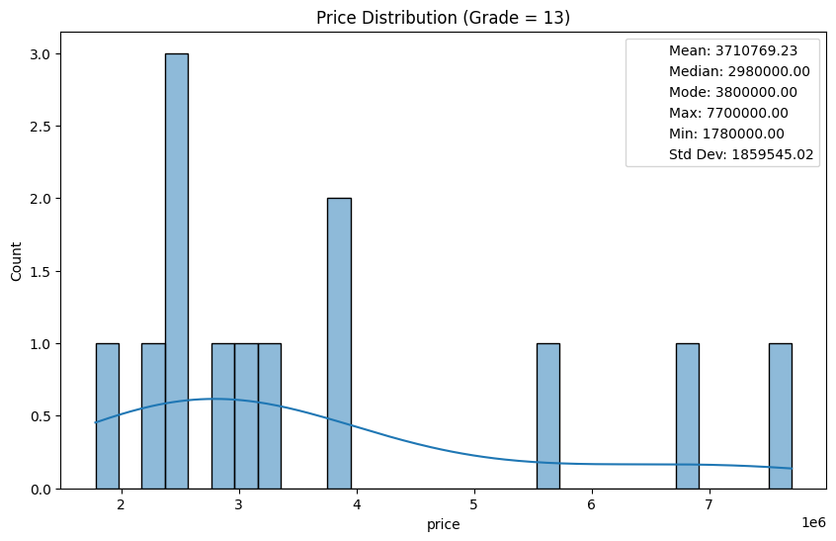
1. Hypotheses: The lower the grade and condition, the cheaper the houses Price distribution of grades 3-13
Mean price in dollar
Grade 9: 774,000
Grade 10: 1,072,00 0
Grade 11: 1,498,000
Grade 12: 2,203,000
Grade 13: 3,711,000
Median price in dollar
Grade 9: 720,000
Grade 10: 914,000
Grade 11: 1,280,000
Grade 12: 1,820,000
Grade 13: 2,980,000
Mode price in dollar
Grade 9: 650,000
Grade 10: 1,050,00
Grade 11: 1,150,000
Grade 12: 1,490,000
Grade 13: 3,800,000
Std price in dollar
Grade 9: 317,000
Grade 10: 484,000
Grade 11: 705,000
Grade 12: 1,029,000
Grade 13: 1,859,000
Max price in dollar
Grade 9: 2,300,000
Grade 10: 3,600,000
Grade 11: 7,060,000
Grade 12: 5,350,000
Grade 13: 7,700,000
Min price in dollar
Grade 9: 230,000
Grade 10: 316,000
Grade 11: 420,000
Grade 12: 835,000
Grade 13: 178,000
Hypothesis is right
Seaborn and Matplotlib

Slide 22
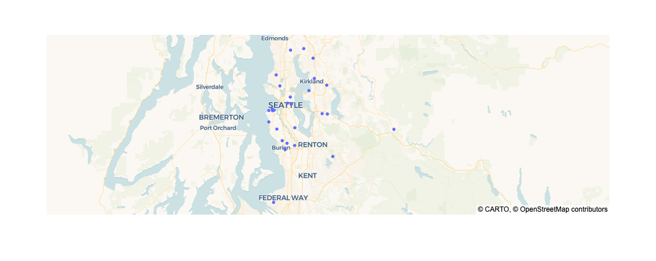
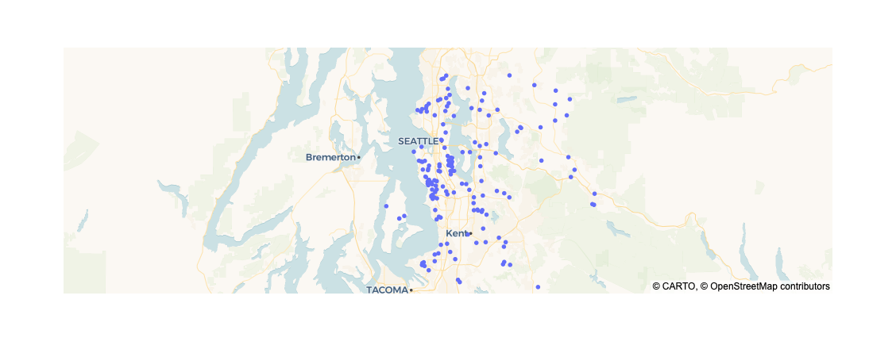
Hypothesis 2: Cheap houses are accumulated in a specific council district
Definition cheap houses: Up to 120,000 dollars
Definition cheap houses: Clustered by the condition
Distribution of condition 1
Hier wäre es nice die Distrikte von King County zu sehen
Distribution of condition 2

Slide 23
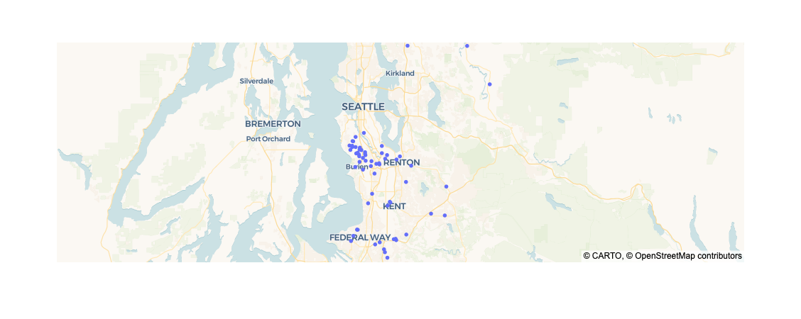
3. Hypotheses: Cheap houses are accumulated in a specific area (clustered together)
Definition cheap houses: Up to 120,000 dollars
Distribution of house prices up to 120,000 dollars
→ Cheap houses are not clustered together in specific areas

